Slide 1
Mathematical Foundations for Data Science
MFDS Team

Slide 2
DSECL ZC416, MFDS
Lecture No. 14

Slide 3
Agenda
Combinatorial Proofs
Binomial Coefficients
Binomial theorem
Recurrence Relations
Application of Recurrence Relations

Slide 4
Combinatorial Proofs
Definition 1: A combinatorial proof of an identity is a proof that uses one of the following methods.
A double counting proof uses counting arguments to prove that both sides of an identity count the same objects, but in different ways.
A bijective proof shows that there is a bijection between the sets of objects counted by the two sides of the identity.

Slide 5

Double Counting Proof
Combinatorial proofs that C(n, r) = C(n, n − r) when r and n are nonnegative integers with r <= n
: By definition the number of subsets of S with r elements is C(n, r).
Each subset A of S can also be described by specifying which elements are not in A, i.e., those which are in .
Since the complement of a subset of S with r elements has n − r elements, there are also C(n, n − r) subsets of S with r elements.

Slide 6
Bijective Proof
Combinatorial proofs that C(n, r) = C(n, n − r) when r and n are nonnegative integers with r < =n
Suppose that S is a set with n elements.
The function that maps a subset A of S to is a bijection between the subsets of S with r elements and the subsets with n − r elements.
Since there is a bijection between the two sets, they must have the same number of elements.

Slide 7
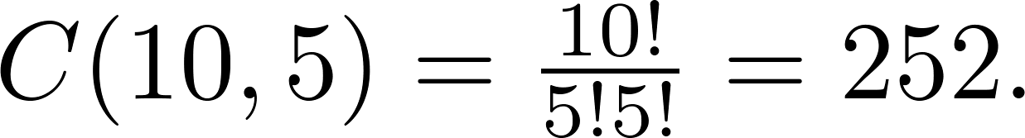
Combinations
Example: How many ways are there to select five players from a 10-member tennis team to make a trip to a match at another school.
Solution: By Theorem 2, the number of combinations is

Slide 8
Combinations
Example: A group of 30 people have been trained as astronauts to go on the first mission to Mars. How many ways are there to select a crew of six people to go on this mission?
Solution: By Theorem 2, the number of possible crews is

Slide 9
Powers of Binomial Expressions
Definition: A binomial expression is the sum of two terms, such as x + y. (More generally, these terms can be products of constants and variables.)
We can use counting principles to find the coefficients in the expansion of
(x + y)^{n} where n is a positive integer.
To illustrate this idea, we first look at the process of expanding (x + y)³.
(x + y) (x + y) (x + y) expands into a sum of terms that are the product of a term from each of the three sums.

Slide 10


Powers of Binomial Expressions
Terms of the form x³, x²y, x y², y³ arise. The question is what are the coefficients?
To obtain x³ , an x must be chosen from each of the sums. There is only one way to do this. So, the coefficient of x³ is 1.
To obtain x²y, an x must be chosen from two of the sums and a y from the other. There are ways to do this and so the coefficient of x²y is 3.
To obtain xy², an x must be chosen from of the sums and a y from the other two . There are ways to do this and so the coefficient of xy² is 3.
To obtain y³ , a y must be chosen from each of the sums. There is only one way to do this. So, the coefficient of y³ is 1.
We have used a counting argument to show that (x + y)³ = x³ + 3x²y + 3x y² + y³ .

Slide 11


Binomial Theorem
Binomial Theorem: Let x and y be variables, and n a nonnegative integer. Then:
Proof: We use combinatorial reasoning .
The terms in the expansion of (x + y)^{n} are of the form x^{n−j}y^{j} for j = 0,1,2,…,n. To form the term x^{n−j}y^{j}, it is necessary to choose n−j x’s from the n sums. Therefore, the coefficient of x^{n−j}y^{j} is which equals .

Slide 12
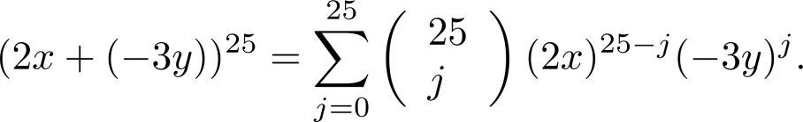
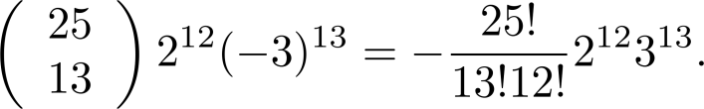
Using the Binomial Theorem
Example: What is the coefficient of x¹²y¹³ in the expansion of (2x − 3y)²⁵?
Solution: We view the expression as (2x +(−3y))²⁵. By the binomial theorem
Consequently, the coefficient of x¹²y¹³ in the expansion is obtained when j = 13.

Slide 13
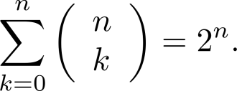
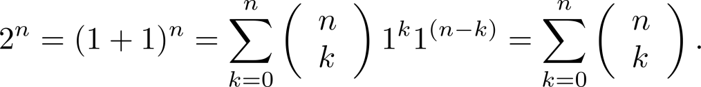




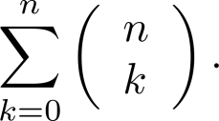
A Useful Identity
Corollary 1: With n ≥0,
Proof (using binomial theorem): With x = 1 and y = 1, from the binomial theorem we see that:
Proof (combinatorial): Consider the subsets of a set with n elements. There are subsets with zero elements, with one element, with two elements, …, and with n elements. Therefore, the total is
Since, we know that a set with n elements has 2^{n} subsets, we conclude:

Slide 14
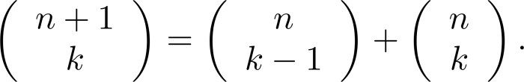

Pascal’s Identity
Pascal’s Identity: If n and k are integers with n ≥ k ≥ 0, then
Proof (combinatorial): Let T be a set where |T| = n + 1, a ∊T, and S = T − {a}. There are subsets of T containing k elements.
Each of these subsets of T either:
contains a with k − 1 other elements, or
contains k elements of S and does not contain a.

Slide 15


Pascal’s Identity
There are
subsets of k elements that contain a, since there are subsets of k − 1 elements of S,
subsets of k elements of T that do not contain a, because there are subsets of k elements of S.
Hence,

Slide 16
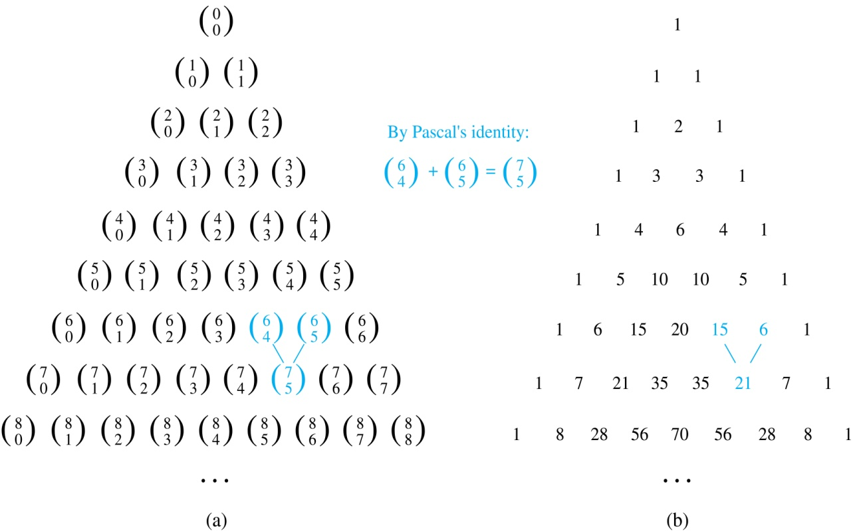
Pascal’s Triangle
The nth row in the triangle consists of the binomial coefficients ,
k = 0,1,….,n.
By Pascal’s identity, adding two adjacent binomial coefficients results is the binomial coefficient in the next row between these two coefficients.

Slide 17
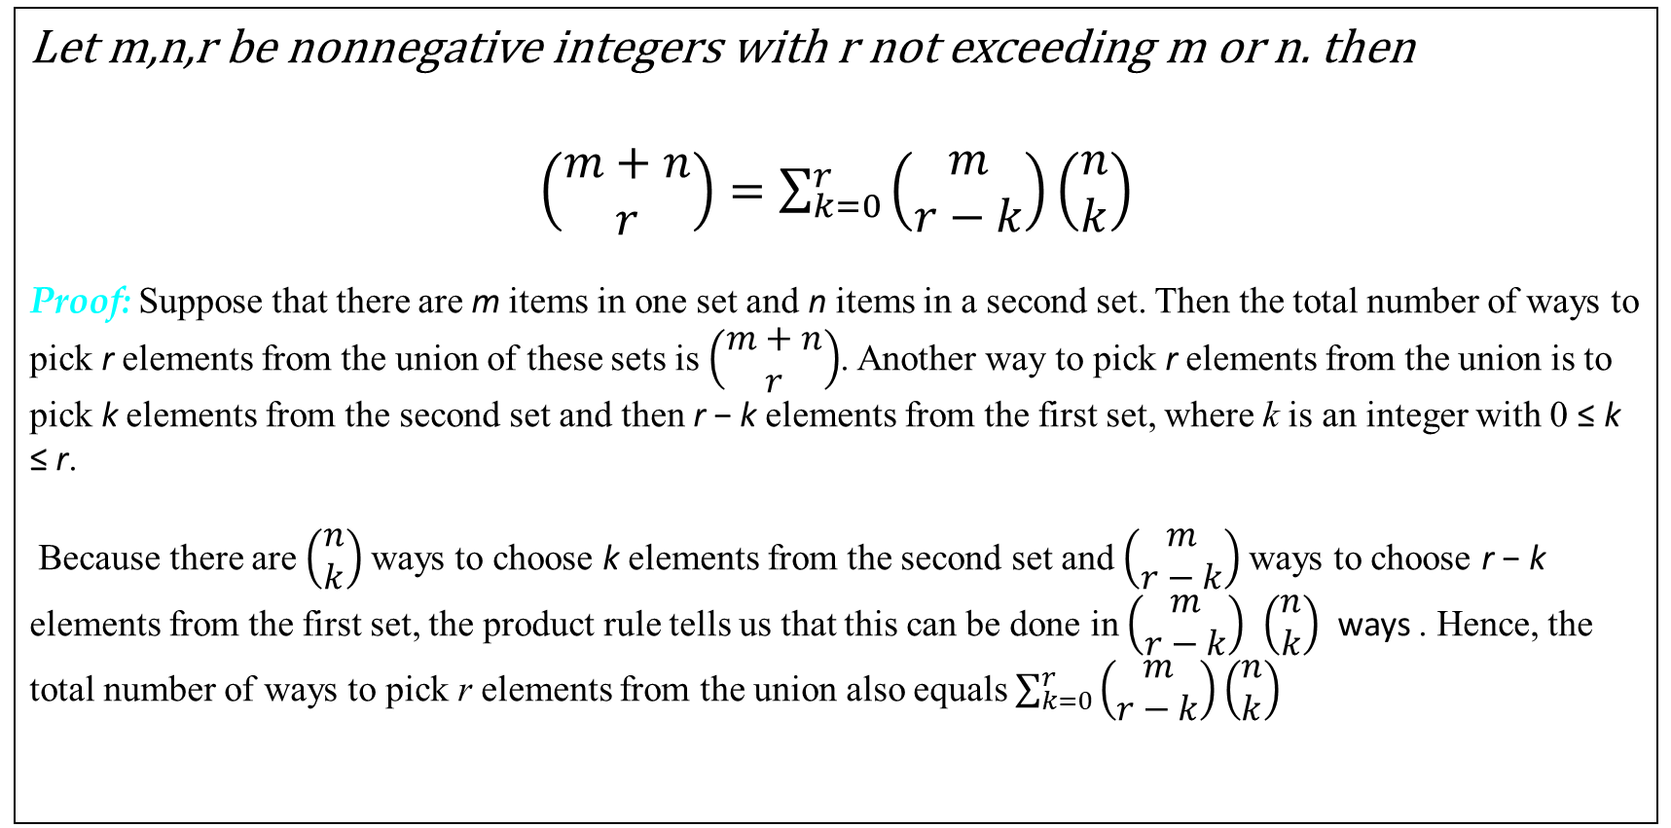
Vandermonde's identity
Let m,n,r be nonnegative integers with r not exceeding m or n. then
$\left(\begin{matrix}m+n \\ r\end{matrix}\right)=\sum_{k=0}^{r}{\left(\begin{matrix}m \\ r−k\end{matrix}\right)}\left(\begin{matrix}n \\ k\end{matrix}\right)$
Proof: Suppose that there are m items in one set and n items in a second set. Then the total number of ways to pick r elements from the union of these sets is $\left(\begin{matrix}m+n \\ r\end{matrix}\right)$. Another way to pick r elements from the union is to pick k elements from the second set and then r − k elements from the first set, where k is an integer with 0 ≤ k ≤ r.
Because there are $\left(\begin{matrix}n \\ k\end{matrix}\right)$ ways to choose k elements from the second set and $\left(\begin{matrix}m \\ r−k\end{matrix}\right)$ways to choose r − k elements from the first set, the product rule tells us that this can be done in $\left(\begin{matrix}m \\ r−k\end{matrix}\right)$ $\left(\begin{matrix}n \\ k\end{matrix}\right)$ ways . Hence, the total number of ways to pick r elements from the union also equals $\sum_{k=0}^{r}{\left(\begin{matrix}m \\ r−k\end{matrix}\right)}\left(\begin{matrix}n \\ k\end{matrix}\right)$

Slide 18
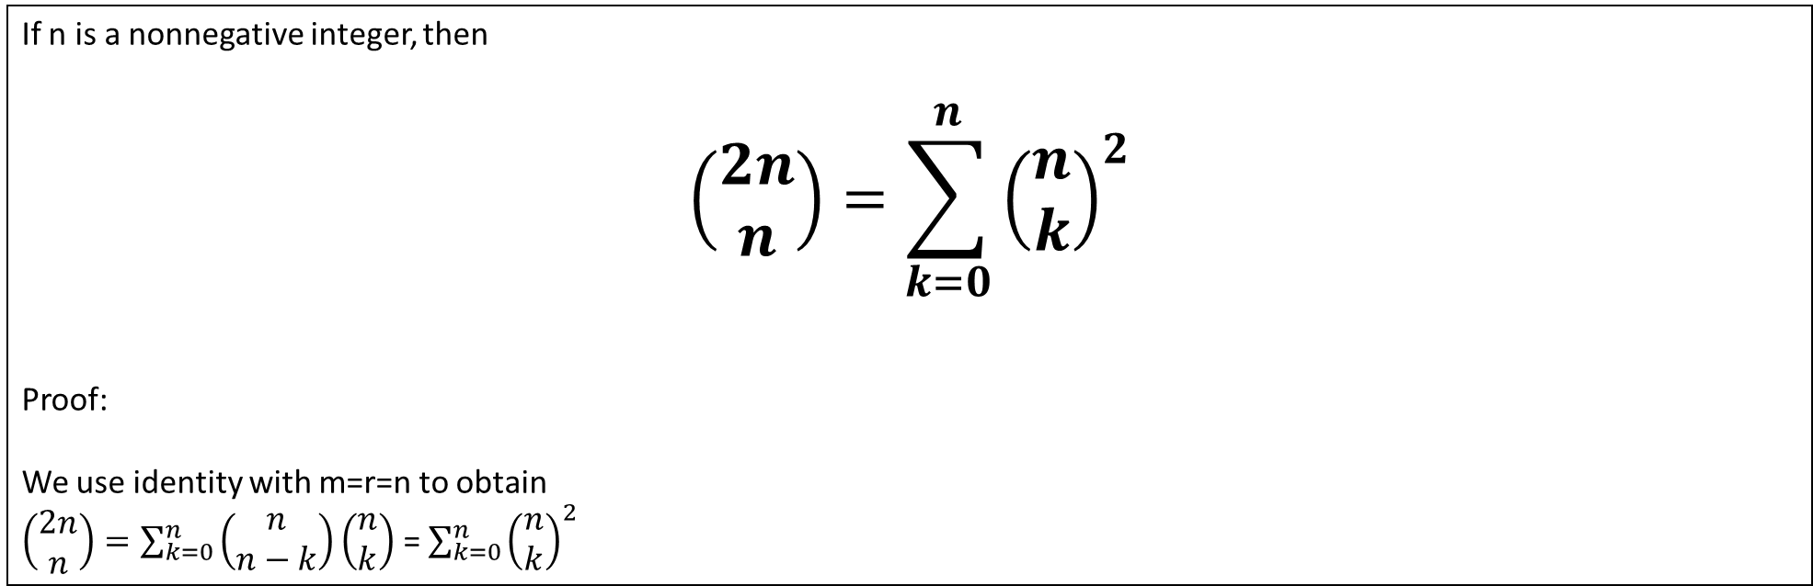
Vandermonde's identity : Corollary
If n is a nonnegative integer, then
$$\left(\begin{matrix}2n \\ n\end{matrix}\right)=\sum_{k=0}^{n}{{\left(\begin{matrix}n \\ k\end{matrix}\right)}^{2}}$$
Proof:
We use identity with m=r=n to obtain
$\left(\begin{matrix}2n \\ n\end{matrix}\right)=\sum_{k=0}^{n}{\left(\begin{matrix}n \\ n−k\end{matrix}\right)}\left(\begin{matrix}n \\ k\end{matrix}\right)$ = $\sum_{k=0}^{n}{{\left(\begin{matrix}n \\ k\end{matrix}\right)}^{2}}$

Slide 19
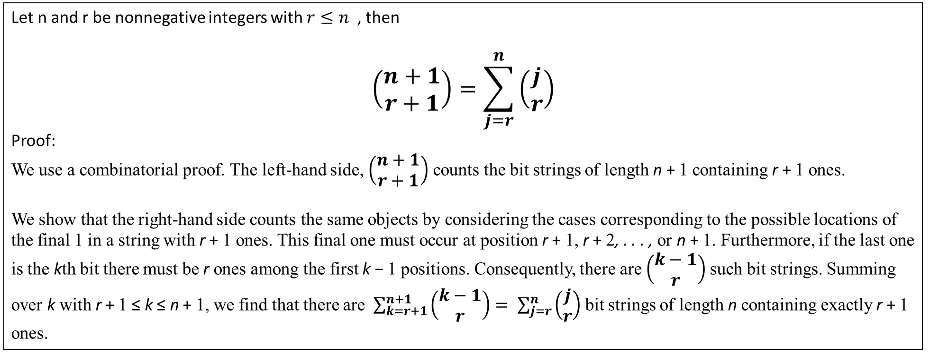
Theorem 4
Let n and r be nonnegative integers with $r≤n$ , then
$$\left(\begin{matrix}n+1 \\ r+1\end{matrix}\right)=\sum_{j=r}^{n}{\left(\begin{matrix}j \\ r\end{matrix}\right)}$$
Proof:
We use a combinatorial proof. The left-hand side, $\left(\begin{matrix}n+1 \\ r+1\end{matrix}\right)$counts the bit strings of length n + 1 containing r + 1 ones.
We show that the right-hand side counts the same objects by considering the cases corresponding to the possible locations of the final 1 in a string with r + 1 ones. This final one must occur at position r + 1, r + 2, . . . , or n + 1. Furthermore, if the last one is the kth bit there must be r ones among the first k − 1 positions. Consequently, there are $\left(\begin{matrix}k−1 \\ r\end{matrix}\right)$such bit strings. Summing over k with r + 1 ≤ k ≤ n + 1, we find that there are$\sum_{k=r+1}^{n+1}{\left(\begin{matrix}k−1 \\ r\end{matrix}\right)}= \sum_{j=r}^{n}{\left(\begin{matrix}j \\ r\end{matrix}\right)}$bit strings of length n containing exactly r + 1 ones.

Slide 20
Recurrence Relations
Definition
A recurrence relation for the sequence {a_{n}} is an equation that expresses a_{n} in terms of one or more of the previous terms of the sequence, namely, a₀, a₁, …, a_{n-1}, for all integers n with n ≥ n₀, where n₀ is a nonnegative integer.
A sequence is called a solution of a recurrence relation if its terms satisfy the recurrence relation.
The initial conditions for a sequence specify the terms that precede the first term where the recurrence relation takes effect.

Slide 21
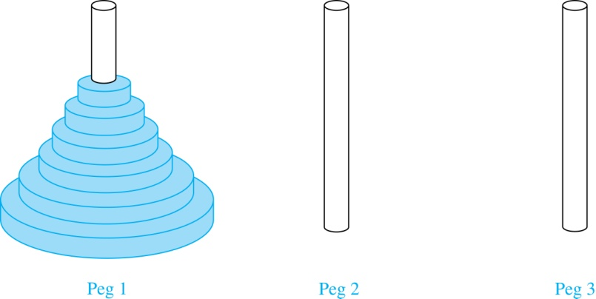
The Tower of Hanoi
In the late nineteenth century, the French mathematician Édouard Lucas invented a puzzle consisting of three pegs on a board with disks of different sizes. Initially all of the disks are on the first peg in order of size, with the largest on the bottom.
Rules: You are allowed to move the disks one at a time from one peg to another as long as a larger disk is never placed on a smaller.
Goal: Using allowable moves, end up with all the disks on the second peg in order of size with largest on the bottom.
The Initial Position in the Tower of Hanoi Puzzle

Slide 22
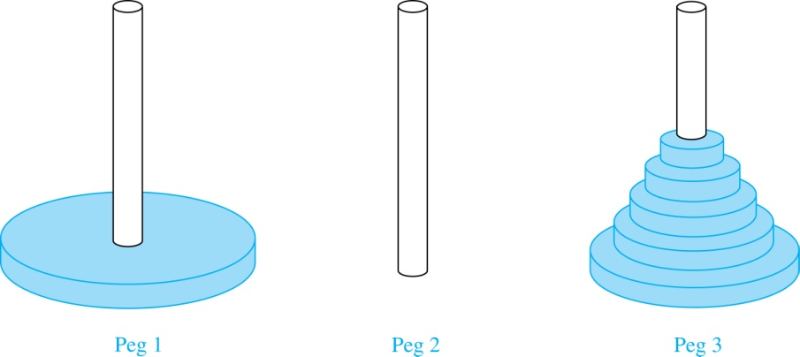
The Tower of Hanoi (continued)
Solution: Let {H_{n}} denote the number of moves needed to solve the Tower of Hanoi Puzzle with n disks. Set up a recurrence relation for the sequence {H_{n}}. Begin with n disks on peg 1. We can transfer the top n −1 disks, following the rules of the puzzle, to peg 3 using H_{n−1} moves.
First, we use 1 move to transfer the largest disk to the second peg. Then we transfer the n −1 disks from peg 3 to peg 2 using H_{n−1} additional moves. This can not be done in fewer steps. Hence,
H_{n} = 2H_{n−1} + 1.
The initial condition is H₁= 1 since a single disk can be transferred from peg 1 to peg 2 in one move.

Slide 23
The Tower of Hanoi (continued)
We can use an iterative approach to solve this recurrence relation by repeatedly expressing H_{n} in terms of the previous terms of the sequence.
H_{n} = 2H_{n−1} + 1
= 2(2H_{n−2} + 1) + 1 = 2² H_{n−2} +2 + 1
= 2²(2H_{n−3} + 1) + 2 + 1 = 2³ H_{n−3} +2² + 2 + 1
⋮
= 2^{n-1}H₁ + 2^{n−2} + 2^{n−3} + …. + 2 + 1
= 2^{n−1} + 2^{n−2} + 2^{n−3} + …. + 2 + 1 because H₁= 1
= 2^{n} − 1 using the formula for the sum of the terms of a geometric series

Slide 24
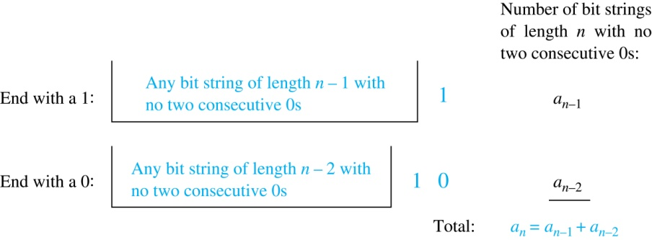
Counting Bit Strings
Example 3: Find a recurrence relation and give initial conditions for the number of bit strings of length n without two consecutive 0s. How many such bit strings are there of length five?
Solution: Let a_{n} denote the number of bit strings of length n without two consecutive 0s. To obtain a recurrence relation for {a_{n} } note that the number of bit strings of length n that do not have two consecutive 0s is the number of bit strings ending with a 0 plus the number of such bit strings ending with a 1. Now assume that n ≥ 3.
The bit strings of length n ending with 1 without two consecutive 0s are the bit strings of length n −1 with no two consecutive 0s with a 1 at the end. Hence, there are a_{n−1} such bit strings.
The bit strings of length n ending with 0 without two consecutive 0s are the bit strings of length n −2 with no two consecutive 0s with 10 at the end. Hence, there are a_{n−2} such bit strings.
We conclude that a_{n} = a_{n−1} + a_{n−2} for n ≥ 3.

Slide 25
Bit Strings (continued)
The initial conditions are:
a₁ = 2, since both the bit strings 0 and 1 do not have consecutive 0s.
a₂ = 3, since the bit strings 01, 10, and 11 do not have consecutive 0s, while 00 does.
To obtain a₅ , we use the recurrence relation three times to find that:
a₃ = a₂ + a₁ = 3 + 2 = 5
a₄ = a₃ + a₂ = 5+ 3 = 8
a₅ = a₄ + a₃ = 8+ 5 = 13
Note that {a_{n} } satisfies the same recurrence relation as the Fibonacci sequence. Since a₁ = f₃ and a₂ = f₄ , we conclude that a_{n} = f_{n+2} .

Slide 26
Counting the Ways to Parenthesize a Product
Example
Find a recurrence relation for C_{n} , the number of ways to parenthesize the product of n + 1 numbers, x₀ ∙ x₁ ∙ x₂ ∙ ⋯ ∙ x_{n}, to specify the order of multiplication.
For example, C₃ = 5, since all the possible ways to parenthesize 4 numbers are
((x₀ ∙ x₁ )∙ x₂ )∙ x₃
(x₀ ∙ (x₁ ∙ x₂ ))∙ x₃
(x₀ ∙ x₁ )∙ (x₂ ∙ x₃ )
x₀ ∙ (( x₁ ∙ x₂ ) ∙ x₃ )
x₀ ∙ ( x₁ ∙ ( x₂ ∙ x₃ ))

Slide 27
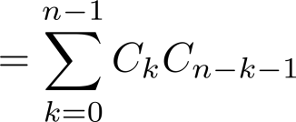
Counting the Ways to Parenthesize a Product
Solution:
Note that however parentheses are inserted in x₀ ∙ x₁ ∙ x₂ ∙ ⋯ ∙ x_{n}, one “∙” operator remains outside all parentheses.
This final operator appears between two of the n + 1 numbers, say x_{k} and x_{k+1}.
Since there are C_{k} ways to insert parentheses in the product x₀ ∙ x₁ ∙ x₂ ∙ ⋯ ∙ x_{k} and C_{n−k−1} ways to insert parentheses in the product x_{k+1} ∙ x_{k+2} ∙ ⋯ ∙ x_{n}, we have
The initial conditions are C₀ = 1 and C₁ = 1.
The sequence {C_{n} } is the sequence of Catalan Numbers. This recurrence relation can be solved using the method of generating functions; see Exercise 41 in Section 8.4.

